Slide 1

Azure webinar series
Best Practices to Secure Your Azure Kubernetes Cluster Part2
Notes:
Replace cover image: go to Format Background > Picture or texture file
Adjust gradient: go to View > Slide Master > Adjust shape fill options

Slide 2
Welcome

Slide 3


Meet our speaker
Mohammad Nofal
Cloud Native Compute Architect – Global Black Belt Team – EMEA
@mohmd_nofal
Notes:
Speaker image: Insert/Paste image > Picture Format > Crop > Aspect Ratio 1:1 > Crop > Crop to shape (circle) > Resize to template

Slide 4
Contents
Security
Concepts
Controlling Egress and Ingress Traffic Flows in AKS
Others Security
Demo
Notes:
test

Slide 5
Previously in Part 1
https://aka.ms/aks-sec-p1

Slide 6



What We Covered in Part1
https://aka.ms/aks-sec-p1
Cluster and Node level security
Authentication and Authorization using AAD and RBAC
Automatic security patching nightly
Nodes deployed in private virtual network subnet w/o public addresses
K8s Dashboard Security
Internal User
External User
Azure Container Registry
App Gateway
Developer
AKS with RBAC
2
Image and container level security
AAD authenticated Container registry access
ACR image scanning and content trust for image validation
Internal Load Balancer
External Load Balancer
1
Azure VNet
Active Directory
Ingress Controller
Ingress Controller
External DNS
3. Workload level security
Secure access to resources & services (e.g. Azure Key Vault) via Pod Identity
Storage Encryption
App Gateway with WAF to protect against threats and intrusions
Network policy to secure communication paths between namespaces (and nodes)
Security Context, Pod Security Policies, and Open Policy Agent
Node
Node
Pod
Pod
3
AAD Pod Identity

Slide 7
Concepts

Slide 8
Network Plugins in AKS
AKS support 2 network plugins
 | Azure CNI | Kubenet
What is it? | Implementation for the CNI specification | Linux Bridge
How it works? | Nodes and Pods share the VNET CIDR | Nodes attached to VNET Pods are assigned a non routable IP space
Routing? | Not required, as pods are attached to the VNET | Required for cross node communication
When to use? | Always unless you’re constained on private IP addresses | When you’re constainer on the Private IP space

Slide 9
Traffic Flows

Slide 10
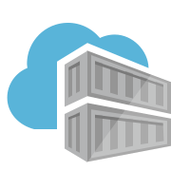






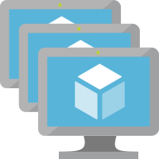

Vanilla AKS – Ingress and Egress Flows (Azure CNI)
ACR
Internet
Egress – SLB Public IP
Azure required services
On Prem Network
AKS VNET
Worker-Subnet1
:9000, :443
Azure Managed Account
NSG
AKS-HCP
Peering
ILB
AKS1-VMSS1-NicX
SLB
NSG
Ingress – SLB Public IP
Developer VNET
Peering
Egress traffic
CI /CD Toolchain
ingress traffic
Kubectl

Slide 11
Vanilla AKS – Ingress and Egress Flows (Kubenet)
ACR
Internet
NSG
Egress – SLB Public IP
Azure required services
On Prem Network
AKS VNET
Worker-Subnet1
:9000, :443
Azure Managed Account
AKS1-VMSS1-NicX
AKS-HCP
Peering
ILB
SLB
NSG
Ingress – SLB Public IP
Developer VNET
Peering
Egress traffic
CI /CD Toolchain
ingress traffic
Kubectl

Slide 12
Setup Notes
AKS requires public IP assigned to the SLB to egress to internet (examples on why)
Egress to the API server which “by default” is assigned a public IP
Downloading operating system “security” patches
Pod egress traffic leaving the node will be NAT-ed to the node private IP address, so if you’re egressing to a peered network the sources traffic will always be a node IP address
AKS automatically assigns a Network security group (NSG) to the cluster which is “immutable”
In CNI the NSG is attached to the Nodes NICs
This allows you to configure an NSG of your choice on the subnet(s) where the node pool(s) is/are
In Kubenet the NSG is assigned to the subnet

Slide 13
How to secure the API Server (control plane)
Enable Azure AD integration with RBAC (required for AuthN and AuthZ)
Only allow whitelisted networks to access the API server ”Authorized IP Range” feature
Can be enabled at provisioning or during run time
$ az aks create -n clustername -g resourcegroup \ --api-server-authorized-ip-ranges your.firewall.ip.address/32,more,ips,…
$ az aks update -n clustername -g resourcegroup \ --api-server-authorized-ip-ranges your.firewall.ip.address/32,more,ips,…

Slide 14
We have 3rd party providers who require IP whitelisting
Configure the standard load balnacer outbound IP prefix
$ az aks create -n clustername -g resourcegroup \ --load-balancer-outbound-ip-prefixes resourcesIDs-of-IPs,more, IDs,…
$ az aks update -n clustername -g resourcegroup \ --load-balancer-outbound-ip-prefixes resourcesIDs-of-IPs,more, IDs,…

Slide 15
Advanced Egress Flows

Slide 16
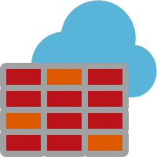

Controlling Egress – Azure Firewall
ACR
Hub VNET
Internet
NSG
Azure required services
Egress – SLB Public IP
AKS Spoke VNET
Worker-Subnet1
AZFW-PublicIP
:9000, :443
Azure Managed Account
AKS1-VMSS1-NicX
Azure Firewall
AKS-HCP
SLB
Worker-Subnet1
NSG
UDR
Kubectl
CI /CD Toolchain
Peering
Egress traffic
ingress traffic

Slide 17


Controlling Egress – Azure Firewall and Service Endpoints (Spoke Subnet)
ACR
Hub VNET
Internet
NSG
Azure required services
Egress – SLB Public IP
AKS Spoke VNET
Worker-Subnet1
AZFW-PublicIP
:9000, :443
Azure Managed Account
AKS1-VMSS1-NicX
Azure Firewall
AKS-HCP
SLB
Worker-Subnet1
NSG
UDR
Kubectl
CI /CD Toolchain
Service Endpoint
Service Endpoint Traffic
Peering
Egress traffic
ingress traffic
Azure MySQL

Slide 18
Controlling Egress – Azure Firewall and Service Endpoints (FW Subnet)
ACR
HUB VNET
Internet
NSG
Azure required services
Egress – SLB Public IP
AKS Spoke VNET
Worker-Subnet1
AZFW-PublicIP
:9000, :443
Azure Managed Account
AKS1-VMSS1-NicX
Azure Firewall
AKS-HCP
SLB
Worker-Subnet1
NSG
Servie Endpoint
UDR
Kubectl
CI /CD Toolchain
Service Endpoint
Service Endpoint Traffic
Peering
Egress traffic
Azure MySQL
ingress traffic

Slide 19
Setup Notes
Any NVA (network virtual appliance) can be used instead of Azure Firewall
Azure Firewall is managed and supports service tags which makes it easy to setup and implements
AKS requires specific FQDNs to be whitelisted in the firewall, check for the latest https://aka.ms/aks/egress
The AKS control plane doesn’t support service tags yet
When using “Authorized IP Ranges” for the API the firewall IP must be added too.
The UDR to Firewall need to be added after provisioning in case of Kubenet (Route-table merge is coming soon)
Service endpoints can be used to force tunnel the traffic towards azure managed services
On the workload subnet (supersedes the FW UDR)
On the FW subnet, all traffic will be inspected by FW first (watch out for peering traffic charges)

Slide 20
But we don’t need public IP on the SLB – OutboundType= userDefinedRouting (Preview)
ACR
HUB VNET
Internet
NSG
Azure required services
AKS Spoke VNET
Worker-Subnet1
AZFW-PublicIP
:9000, :443
Azure Managed Account
AKS1-VMSS1-NicX
Azure Firewall
SLB
UDR
AKS-HCP
Worker-Subnet1
NSG
UDR
Kubectl
CI /CD Toolchain
Service Endpoint Traffic
Peering
Egress traffic
ingress traffic

Slide 21
Outbound-type=userDefinedRouting (Preview)
AKS now allows to configure the outbound-type for the Standard Loadbalancer
The new parmeters will allow you to choose between ‘Loadbalancer’ current default behavior, or
Outbound-type=userDefinedRouting , in this model the assumption is that you have a NVA/FW in place which you can route all the traffic to, and this NVA will handle the egress to the internet
Straightforward to accomplish with CNI
Soon to come to kubenet, once Merging route tables is supported https://docs.microsoft.com/en-us/azure/aks/egress-outboundtype

Slide 22

But we don’t need the Control Plane to have public IP! Full Private AKS
Azure Managed Account
NSG
AKS-HCP
AKS with private Link
AKS Spoke VNET
Worker-Subnet1
AKS PE
HUB VNET
AKS1-VMSS1-NicX
SLB
UDR
AZFW-PublicIP
Azure Firewall
UDR
Service Endpoint
Worker-Subnet1
ACR
Private Link Traffic
Internet
Service Endpoint Traffic
Peering
Egress traffic
Kubectl
CI /CD Toolchain
Azure required services
ingress traffic
Azure MySQL

Slide 23
Private Link Notes
API server will be assigned a Private Endpoint which will be assigned an IP address from your VNET
The API IP address can’t be pre-determined yet!
Privte Endpoint traffic can’t be NSG’ed (Yet!)
If using a firewall you still need to do the required whitelisting for AKS to function properly https://aka.ms/aks/egress
You can’t use custom DNS servers yet! https://docs.microsoft.com/en-us/azure/aks/private-clusters

Slide 24
Advanced Ingress Flows

Slide 25
AKS with Ingress Subnet
ACR
Ingress-Subnet
Internet
NSG
Ingress – SLB Private IP
Egress – SLB Public IP
Azure required services
AKS VNET
Worker-Subnet1
On Prem Network
AKS1-VMSS1-NicX
:9000, :443
Azure Managed Account
AKS-HCP
Peering
SLB
NSG
NSG
Service Endpoint
Developer VNET
Service Endpoint Traffic
Peering
Egress traffic
CI /CD Toolchain
ingress traffic
Kubectl
Azure MySQL

Slide 26
AKS Ingress Subnet + AZ Firewall
ACR
HUB VNET
Internet
Egress – SLB Public IP
Azure required services
Ingress-Subnet
SLB
Ingress – SLB Private IP
AzFWInternalIP
:9000, :443
Azure Managed Account
NSG
Azure Firewall
AZFW-PublicIP
AKS-HCP
AKS Spoke VNET
ILB
Service Endpoint
Worker-Subnet1
NSG
Worker-Subnet1
AKS1-VMSS1-NicX
Azure MySQL
NSG
UDR
CI /CD Toolchain
On Prem Network
Kubectl
Peering
Service Endpoint Traffic
ILB
Peering
Egress traffic
ingress traffic

Slide 27
AKS with Ingress Subnet + WAF (APP GW)
ACR
WAF-Subnet
Internet
NSG
App GW Private IP
App GW Public IP
HUB VNET
Azure required services
On Prem Network
Worker-Subnet1
Azure Managed Account
AKS SPOKE VNET
Ingress-Subnet
AzFWInternalIP
AKS-HCP
Peering
AKS1-VMSS1-NicX
Azure Firewall
AZFW-PublicIP
Ingress – SLB Private IP
NSG
Service Endpoint
Worker-Subnet1
Azure MySQL
Kubectl
CI /CD Toolchain
Service Endpoint Traffic
NSG
Peering
UDR
Egress traffic
ingress traffic

Slide 28
Benefits of having a dedicated ingress subnet
Clear seperation of concerns between ingress and egress traffic
Extra control on ingress traffic using Network securiity groups on the subnet (very beneficial in case of Kubenet)
Ingress can be owned by features/service team and the WAF (web application firewall) can serve as the contract between the feature and security teams
Using a WAF instead of a Firewall provides better security for Web Applications and you can offload-ssl there

Slide 29
Subnet Per Node Pools
ACR
NodePool2-Subnet2
Internet
NSG
HUB VNET
Azure required services
On Prem Network
UDR
AKSNP2-VMSS2-NicX
NodePool1-Subnet1
Azure Managed Account
AKS SPOKE VNET
Ingress-Subnet
AKS-HCP
AZFW-PublicIP
Peering
Ingress – SLB Private IP
Azure Firewall
AKSNP1-VMSS1-NicX
NSG
Service Endpoint
Worker-Subnet1
Azure MySQL
Kubectl
CI /CD Toolchain
Service Endpoint Traffic
NSG
Peering
UDR
Egress traffic
ingress traffic

Slide 30
Subnet Per Node Pool Notes
Works Flawlessly with CNI
Works Flawlessly with Kubenet if no UDR is pre-exisiting, if a UDR exisit then extra assigment of routes is required
This addresses the use cases where
you require hard isolation between nodes, traffic between subnets can be NSGed
You require different outbound rules per node pool in the firewall
Works with new or existing clusters
$ az aks nodepool add --cluster-name clustername -g resourcegroup --name nodepoolName \ --vnet-subnet-id /subscriptions/XXXXXXXXXXXXXXXX/resourceGroups/XX/providers/Microsoft.Network/virtualNetworks/XX/subnets/XXXXXXXX

Slide 31
Securing East/West Traffic
Pods Network

Slide 32
Securing Pod to Pod Traffic

Slide 33
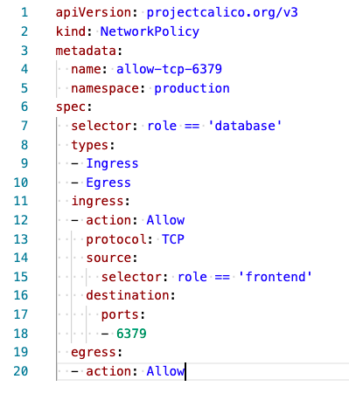
What to consider when using network policies
AKS supports Calico and Azure Network Policy
Calico and Azure Network Policy allows you to create ingress and egress rules based on lables and IPs

Slide 34
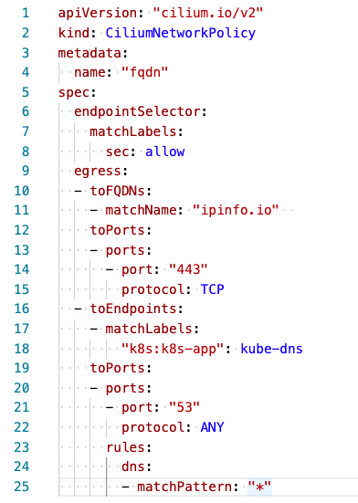
What to consider when using network policies cont…
Cillium, Istio, etc… allows you to create Egress rules based on DNS Names

Slide 35
How can we achieve MTLS between pods and hosts – Enter Service Mesh

Slide 36
Identity and Management

Slide 37
MSI (Managed Service Identity) in AKS
AKS requires an idenity to create resources on behalf of the user i.e. create a volume, create a node, etc…
AKS used to rely on SPs “Service Principals” which came with some challenges like being stored on the nodes and the need to rotate them
MSI is a wrapper for SP, it provides auto rotation and if its system assigned then it has the same life cycle as the resource
To provision an MSI enabled cluster (only enabled on creation time, soon/update exisiting clusters)
$ az aks update -n clustername -g resourcegroup \ --enable-managed-identity

Slide 38
What’s the deal with PSP? (Pod Security Policy)
Pod Security Policies are still beta in upstream Kubernetes with no clear plans on what it will GA
More information on the why its still beta can be found here https://github.com/kubernetes/enhancements/issues/5
AKS will GA PSP if it got GA’ed upstream, though, no clear plans from the upstream community

Slide 39
What’s the alternative for PSP? Enter OPA (Open Policy Agent) – Gatekeeper v3
Gatekeeperv3 is an implemetaion for OPA that’s using CRDs
Coming to AKS soon with integration with Azure policy

Slide 40


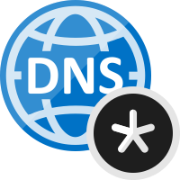




How to Automate DNS Records and Certs
Azure Management VNET
APP GW Subnet
VNet peering
Azure Private DNS Zone
Private IP
Azure AKS VNet
Internal LB
AKS subnet
AKS cluster
Ingress
Cert-Manager
External-DNS
ServiceA
ServiceB
ServiceC

Slide 41
Demo
Pull it all together!

Slide 42
Resources
Demos, slides, and transcript for this webinar can be found here
https://github.com/mohmdnofal/aks-best-practices
AKS Best Practices
https://docs.microsoft.com/en-us/azure/aks/best-practices
Apply Kubernetes Best Practices for Cluster Management Webinar
https://aka.ms/aks-sec-p1
Control egress traffic in cluster nodes for AKS
https://aka.ms/aks/egress
Customize cluster egress with a User-Defined Route (Preview)
https://docs.microsoft.com/en-us/azure/aks/egress-outboundtype
Create a private Azure Kubernetes Service cluster
https://docs.microsoft.com/en-us/azure/aks/private-clusters
Pod Security Policy #5
https://github.com/kubernetes/enhancements/issues/5

Slide 43






Best support for your enterprise need
Learning path aka.ms/LearnKubernetes
What is Kubernetes aka.ms/k8sLearning
Hear from experts aka.ms/AKS/videos
Case studies aka.ms/aks/casestudy
Azure Kubernetes Service aka.ms/AKS/page
Try for free aka.ms/aks/trial

Slide 44
Q&A

Slide 45
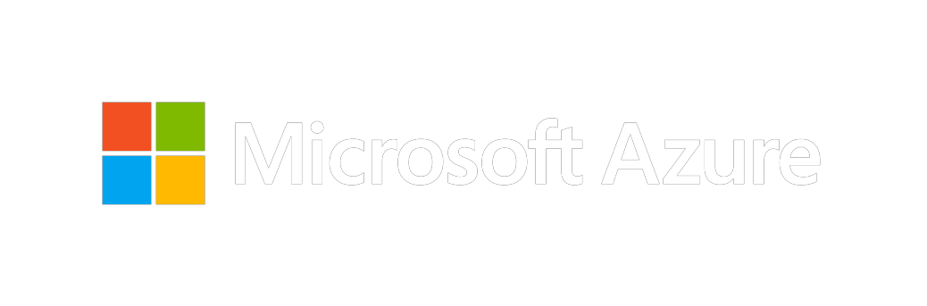
Thank you for joining us.
© 2018 Microsoft Corporation. All rights reserved. Microsoft, Windows, Windows Vista and other product names are or may be registered trademarks and/or trademarks in the U.S. and/or other countries.
The information herein is for informational purposes only and represents the current view of Microsoft Corporation as of the date of this presentation. Because Microsoft must respond to changing market conditions, it should not be interpreted to be a commitment on the part of Microsoft, and Microsoft cannot guarantee the accuracy of any information provided after the date of this presentation. MICROSOFT MAKES NO WARRANTIES, EXPRESS, IMPLIED OR STATUTORY, AS TO THE INFORMATION IN THIS PRESENTATION.

